Slide 1
Ansible and Ansible Tower
Jim Garrett
Senior Solution Architect
jgarrett@redhat.com

Slide 2
What You Will Learn
What is Ansible and The Ansible Way
How Ansible Works and its Key Components
Ad-Hoc Commands
Playbook Basics
Reuse and Redistribution of Ansible Content with Roles
Ansible Tower

Slide 3

WHAT IS ANSIBLE?
Automation Engine
IT Infrastructure
Networks - F5, Arista, Cisco,
Juniper, Open Vswitch
VYOS, others

Slide 4
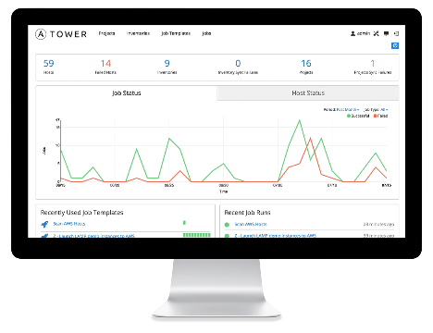
WHAT IS ANSIBLE?
It’s an automation engine - Ansible
Automate What????

Slide 5

Use Cases
Notes:
Config Management – centralized configuration file management and deployment is a common use case

Slide 6
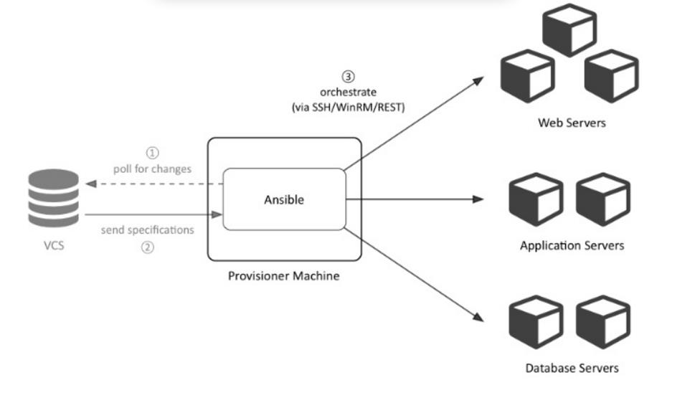
Use Cases
Application Deployment
Notes:
App Deployment – when you manage your application deployment with Ansible and manage the deployment with Tower teams are able to manage the entire application lifecycle from development to production.

Slide 7
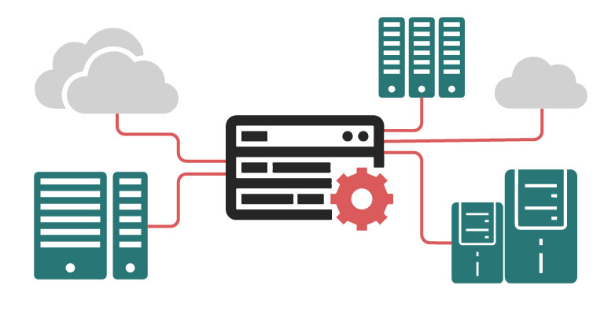
Use Cases
Provisioning
Notes:
Provisioning – Your apps have to live somewhere. If you’re booting and kickstarting bare-metal servers or VM’s, or creating instances from templates, Ansible and Ansible Tower help streamline the process.

Slide 8
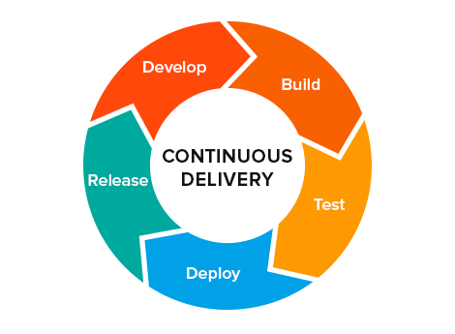
Use Cases
Notes:
Continuous Delivery – Creating a CI/CD pipeline requires buy-in from numerous teams. You can’t do it without a simple automation platform that everyone in your organization can use. Ansible Playbooks keep your applications properly deployed and managed throughout their entire lifecycle

Slide 9
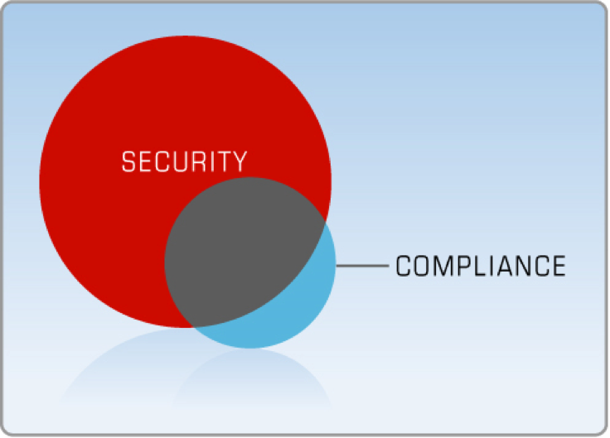
Use Cases
Notes:
Security – When you define your security policy in Ansible, scanning and remediation of site-wide security policy can be integrated into other automated process and instead of being an afterthought, it’ll be integral in everything that is deployed
Orchestration – Configurations alone don’t define your environments. You need to define how multiple configurations interact and ensure the disparate pieces can be managed as a whole. Out of complexity and chaos, Ansible brings order

Slide 10

Use Cases
Orchestration
Notes:
Orchestration – Configurations alone don’t define your environments. You need to define how multiple configurations interact and ensure the disparate pieces can be managed as a whole. Out of complexity and chaos, Ansible brings order

Slide 11
WHAT IS ANSIBLE?
It’s an automation engine - Ansible
It’s an automation language - Ansible Playbooks.
Enterprise framework for controlling, securing and managing your automation – Ansible Tower

Slide 12
SIMPLE
POWERFUL
Agentless
Human readable automation
No special coding skills needed
Tasks executed in order
Get productive quickly
Configuration management
App deployment
Workflow orchestration
Orchestrate the app lifecycle
Agentless architecture
Uses OpenSSH & WinRM
More efficient & more secure

Slide 13
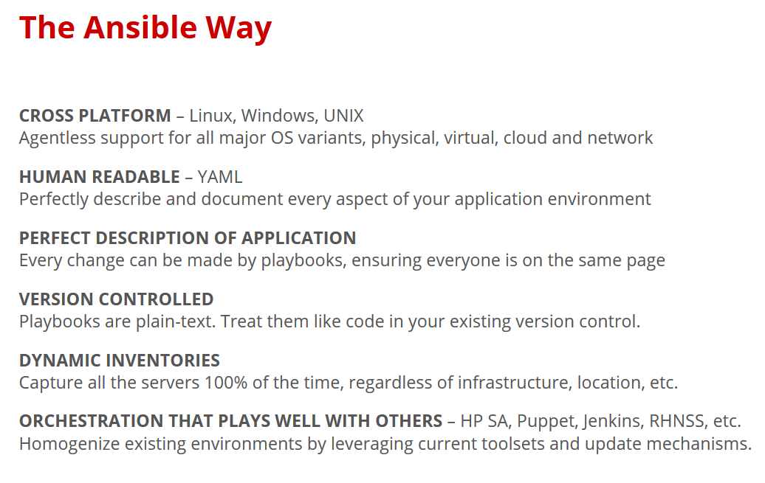

Slide 14
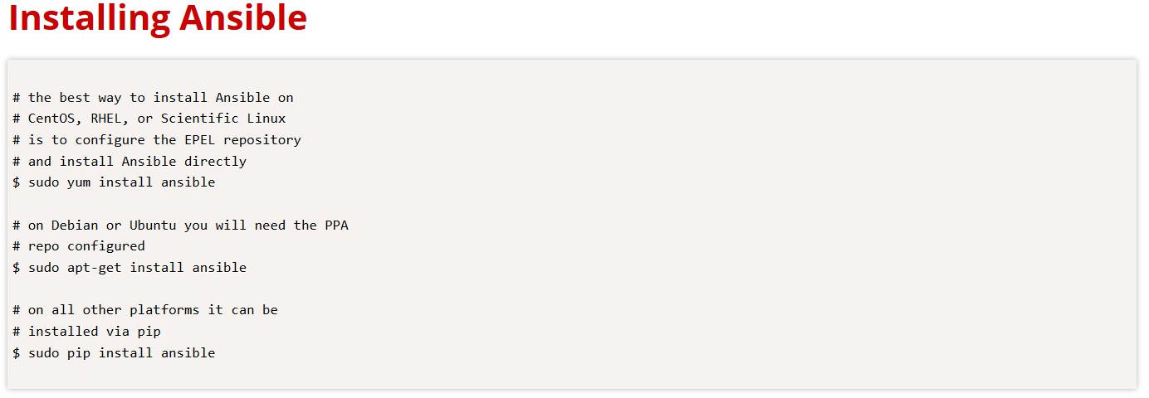

Slide 15
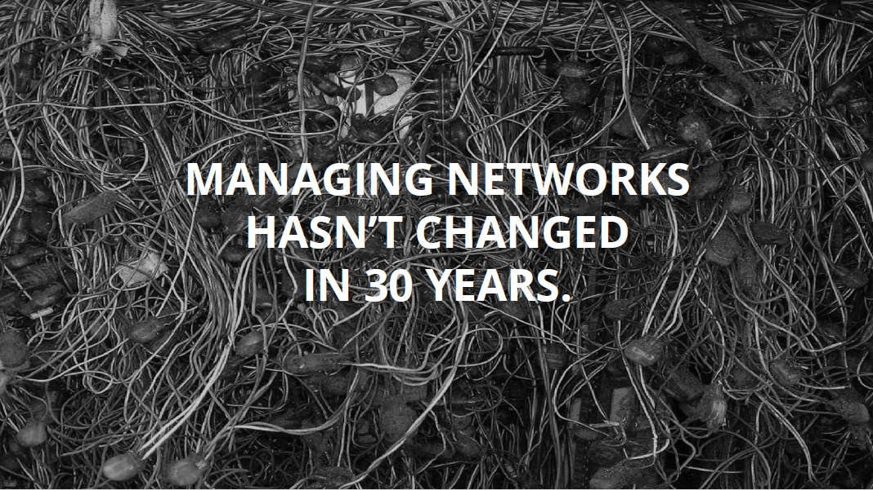

Slide 16
Managing networks hasn’t changed in 30 years
Networks are mission critical
Every network is a unique snowflake
Ad-hoc changes that proliferate
Vendor specific implementations
Testing is expensive/impossible

Slide 17
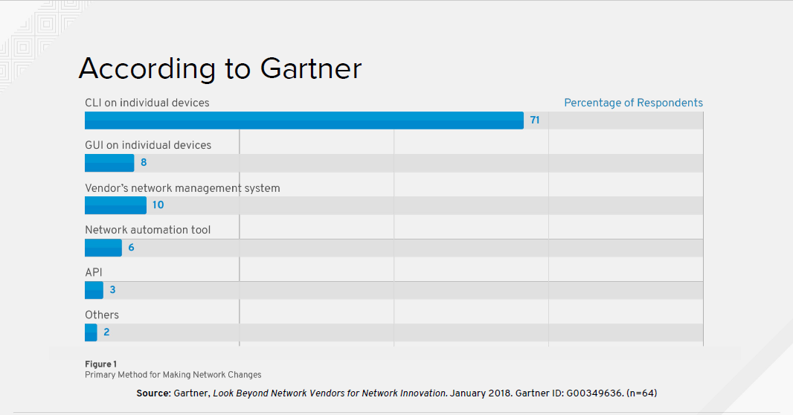
Notes:
Primary method for Making Network Changes
It’s important to note that 71% of network vendors manage their products using Command Line Interfaces

Slide 18
Automatic considerations
Compute is no longer the slowest link in the chain
Businesses demand that networks deliver at the speed of cloud
Automation of repeatable tasks
Bridge silos
Notes:
With the creation of the cloud demand has skyrocketed for faster delivery
Business’s demand that network configuration become a consistent, repeatable automatable process
To meet this need, vendors are turning to Ansible to provide automation at the Network level
In fact, many of the top network vendors are contributing back upstream into the Ansible source code tree, providing new modules that can be used to manager their products

Slide 19
Common Use Cases
Anything an operator can do manually, Ansible can automate
Backup and restore device configurations
Upgrade network device OS
Ensure Configuration Compliance
Apply patches to address CVE (Common Vulnerabilities and Exposures)
Generate dynamic documentation

Slide 20
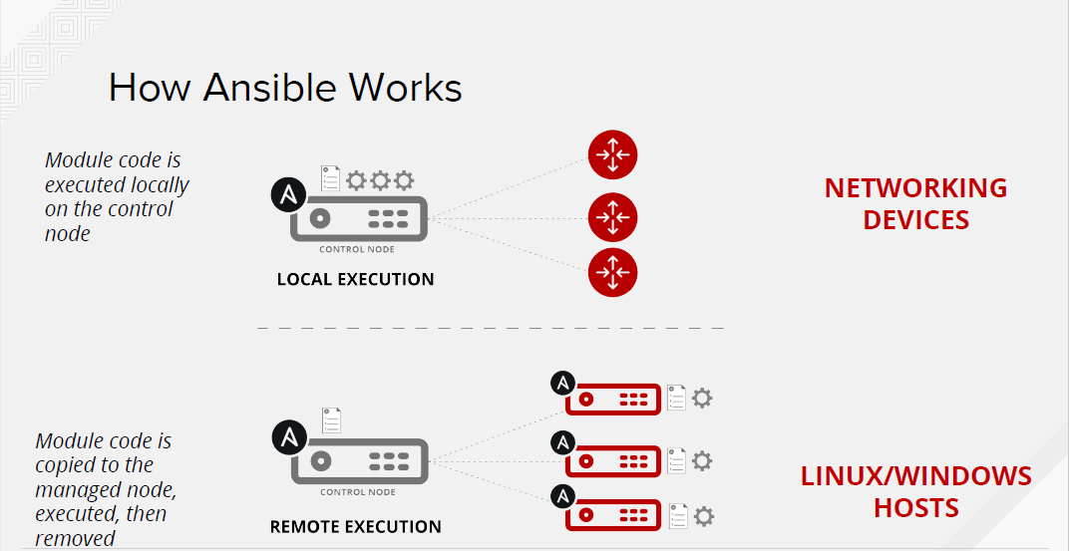

Slide 21
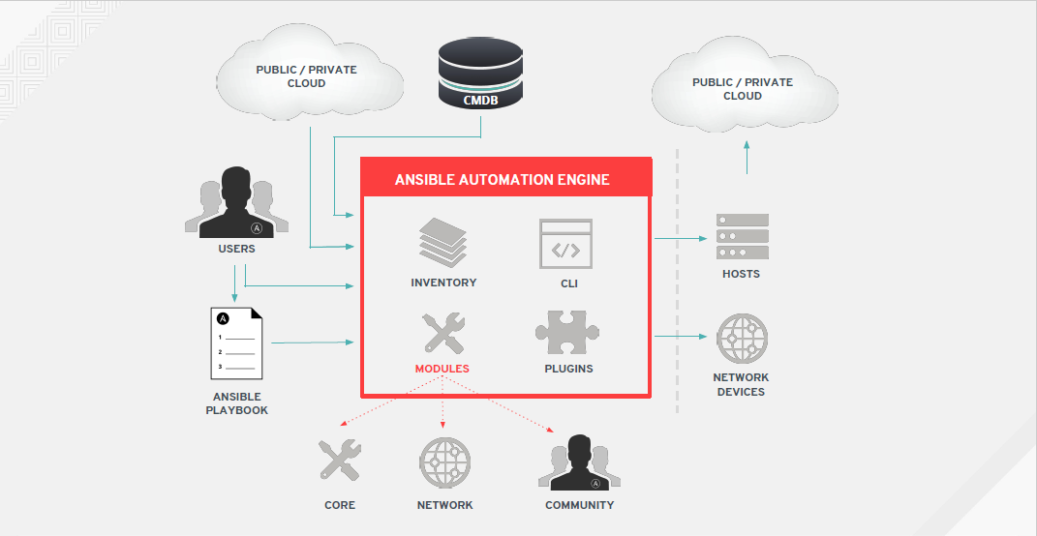

Slide 22
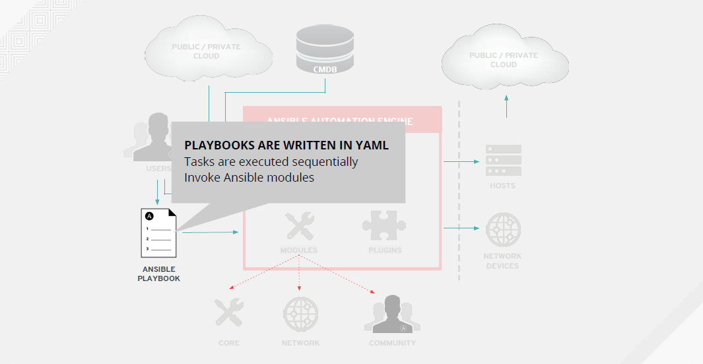

Slide 23
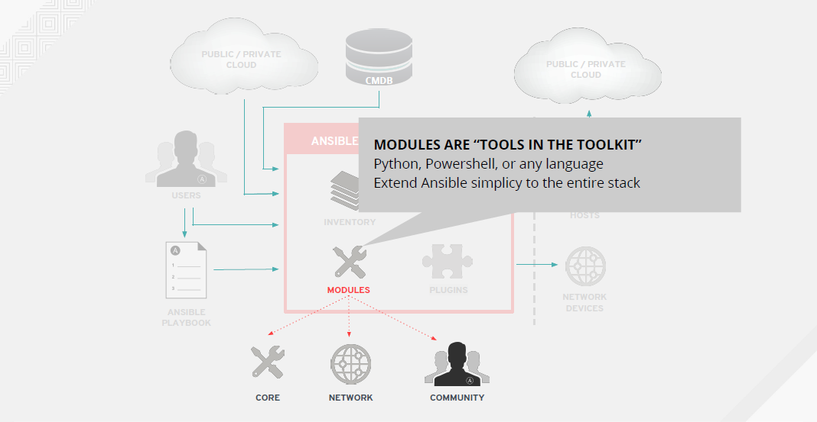

Slide 24
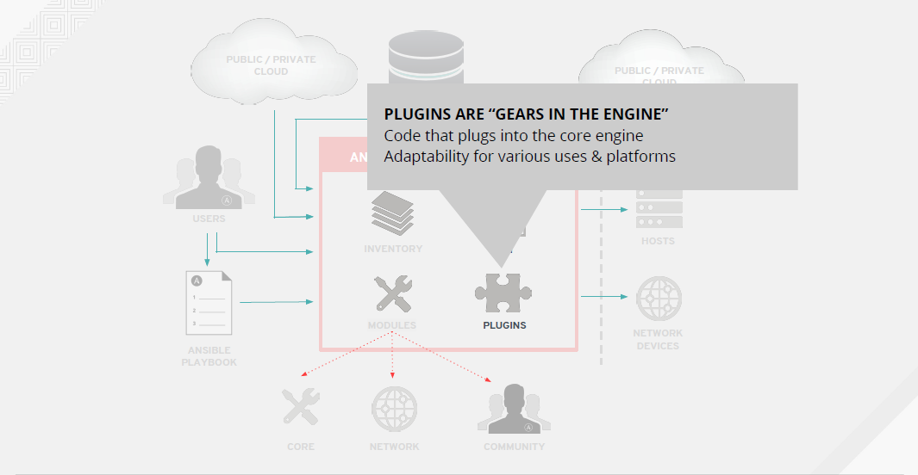

Slide 25
Lab Location
https://github.com/jimgarrett123/ansible-workshop

Slide 26
Lab 1 : Ansible_Install

Slide 27
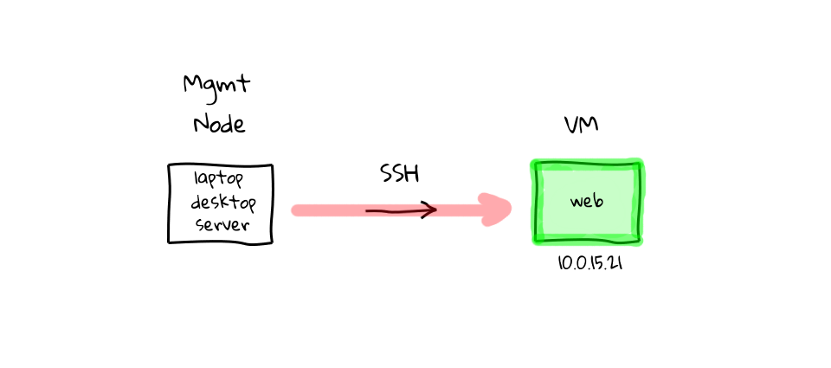
How ANSIBLE Works – Simplicity – Command Line
$ ansible all -m ping

Slide 28
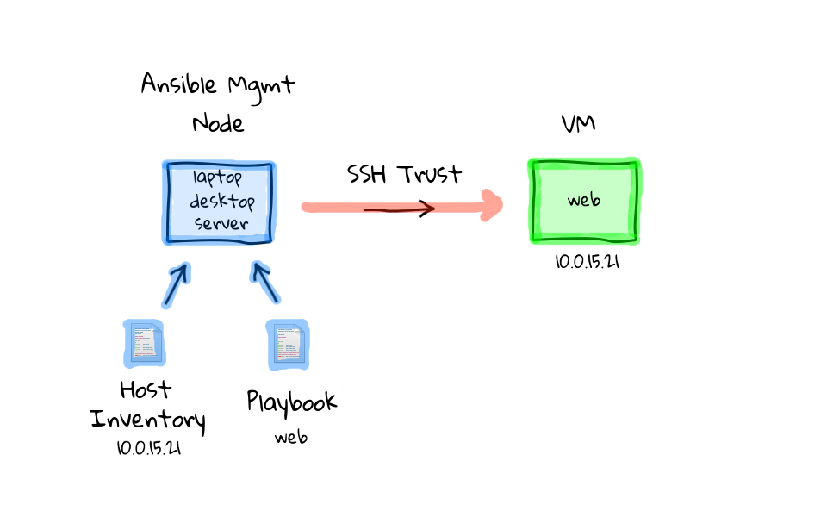
How ANSIBLE Works – Simplicity - playbook
$ ansible-playbook simple_playbook.yml

Slide 29
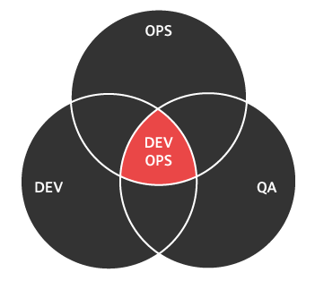
How ANSIBLE Works – Inventory file example
[web] r2d2.example.com c3po.example.com
[dbservers] mysql.example.com postgre.example.com

Slide 30

How ANSIBLE Works – Playbook
---
- name: install and start apache
hosts: web
vars:
http_port: 80
max_clients: 200
remote_user: root
tasks:
- name: install httpd
yum: pkg=httpd state=latest
- name: write the apache config file
template: src=/srv/httpd.j2 dest=/etc/httpd.conf
- name: start httpd
service: name=httpd state=running

Slide 31
How ANSIBLE Works – Playbook
---
- name: install and start apache
hosts: web
vars:
http_port: 80
max_clients: 200
remote_user: root
tasks:
- name: install httpd
yum: pkg=httpd state=latest
- name: write the apache config file
template: src=/srv/httpd.j2 dest=/etc/httpd.conf
- name: start httpd
service: name=httpd state=running

Slide 32
How ANSIBLE Works – Playbook
---
- name: install and start apache
hosts: web
vars:
http_port: 80
max_clients: 200
remote_user: root
tasks:
- name: install httpd
yum: pkg=httpd state=latest
- name: write the apache config file
template: src=/srv/httpd.j2 dest=/etc/httpd.conf
- name: start httpd
service: name=httpd state=running

Slide 33
How ANSIBLE Works – Playbook
---
- name: install and start apache
hosts: web
vars:
http_port: 80
max_clients: 200
remote_user: root
tasks:
- name: install httpd
yum: pkg=httpd state=latest
- name: write the apache config file
template: src=/srv/httpd.j2 dest=/etc/httpd.conf
- name: start httpd
service: name=httpd state=running

Slide 34
How ANSIBLE Works – Playbook
---
- name: install and start apache
hosts: web
vars:
http_port: 80
max_clients: 200
remote_user: root
tasks:
- name: install httpd
yum: pkg=httpd state=latest
- name: write the apache config file
template: src=/srv/httpd.j2 dest=/etc/httpd.conf
- name: start httpd
service: name=httpd state=running

Slide 35
How ANSIBLE Works – Playbook
---
- name: install and start apache
hosts: web
vars:
http_port: 80
max_clients: 200
remote_user: root
tasks:
- name: install httpd
yum: pkg=httpd state=latest
- name: write the apache config file
template: src=/srv/httpd.j2 dest=/etc/httpd.conf
- name: start httpd
service: name=httpd state=running

Slide 36
How ANSIBLE Works – Playbook
---
- name: install and start apache
hosts: web
vars:
http_port: 80
max_clients: 200
remote_user: root
tasks:
- name: install httpd
yum: pkg=httpd state=latest
- name: write the apache config file
template: src=/srv/httpd.j2 dest=/etc/httpd.conf
- name: start httpd
service: name=httpd state=running

Slide 37
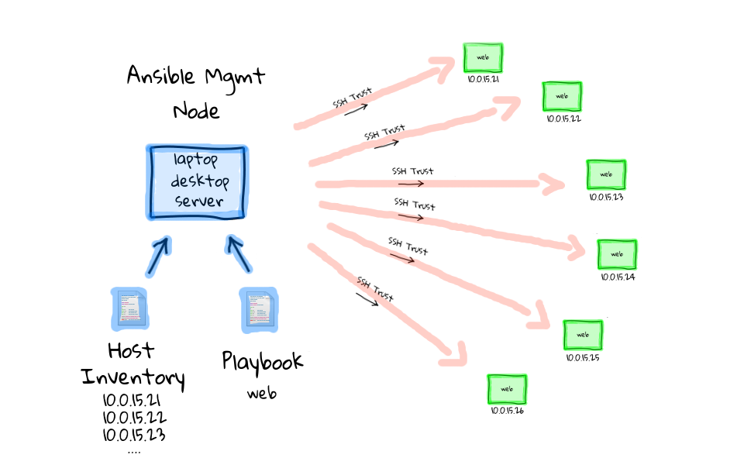
How ANSIBLE Works – at scale
$ ansible-playbook simple_playbook.yml

Slide 38
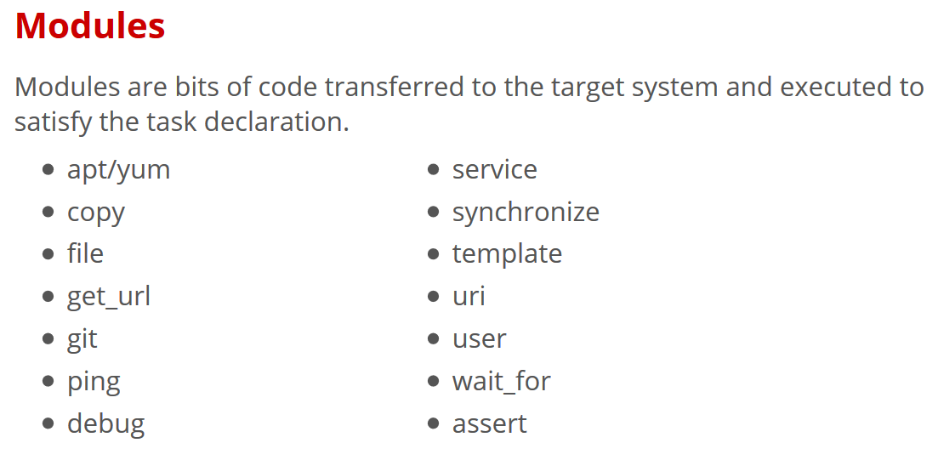
$ ansible all -m ping

Slide 39
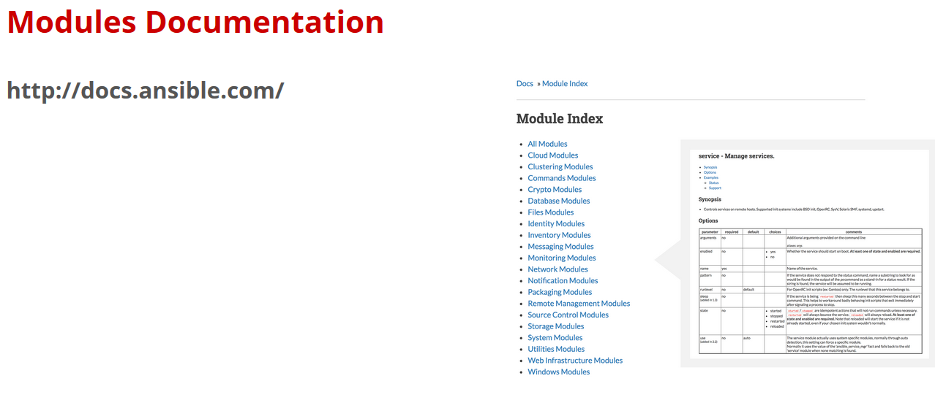

Slide 40
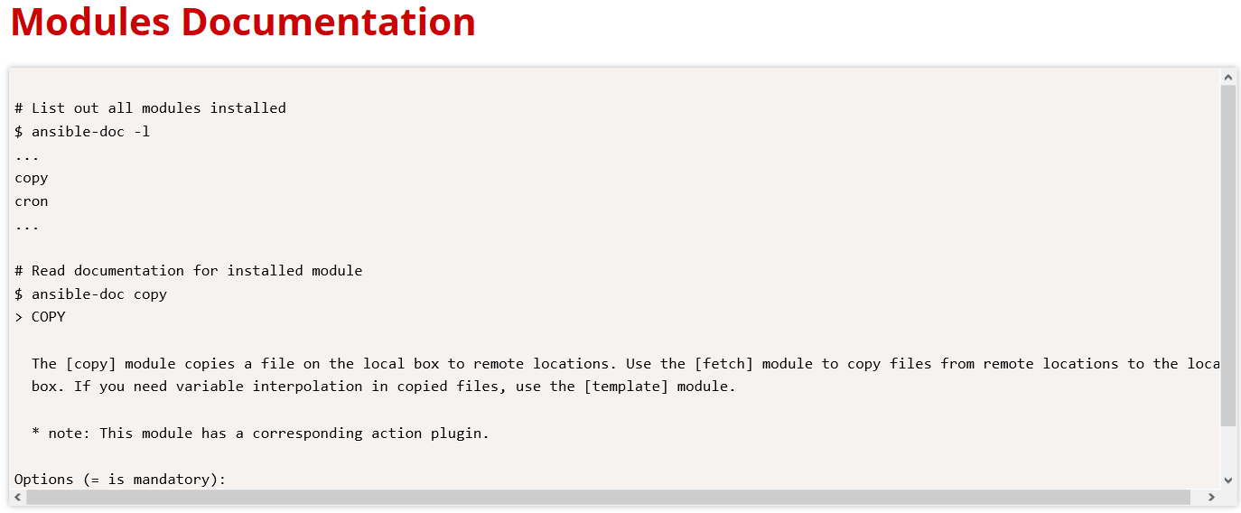

Slide 41
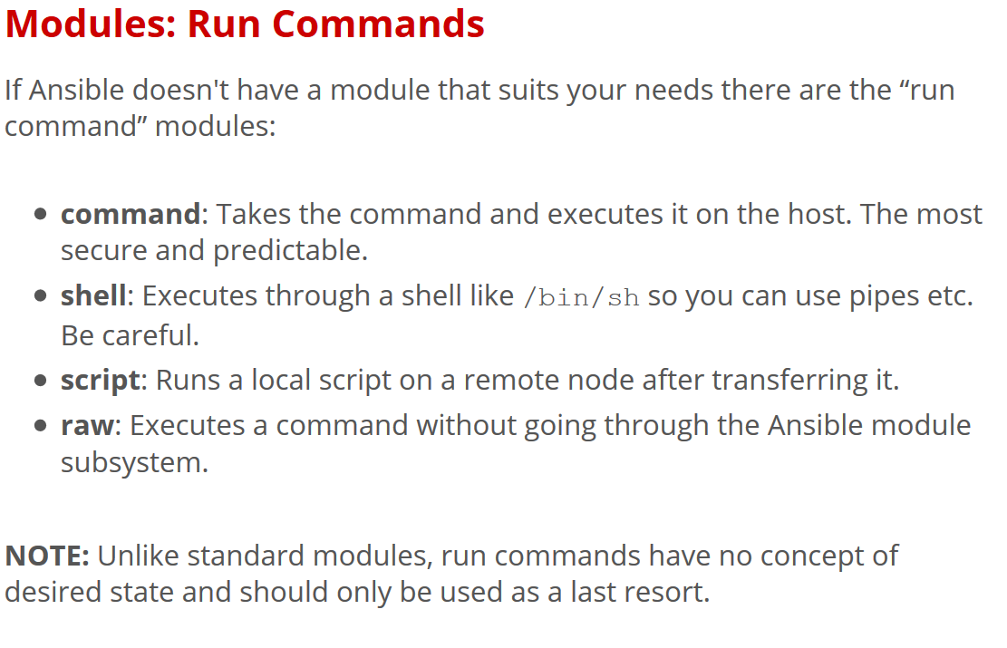

Slide 42
AD-Hoc Commands
# Check all my inventory hosts are ready to be managed
$ ansible all –m ping
# Collect and Display discovered facts for localhost
$ ansible localhost –m setup
# run the uptime command on all hosts in the WEB group
$ ansible web –m command –a “uptime”

Slide 43
Sidebar: Discovered Facts
Facts are bits of information derived from examining a host system, these are stored as variables for later use in the play.
$ ansible localhost –m setup
localhost | success >> {
“ansible_facts”: {
“ansible_default_ipv4”: {
“address”: “192.168.1.27”,
“alias”: “wlan0”,
“gateway: “192.168.1.1”,
“interface: “wlan0”,
“macaddress”: “c4:85:08:3b:a9:16”,
.
.

Slide 44
Lab 2 :Adhoc_Commands

Slide 45
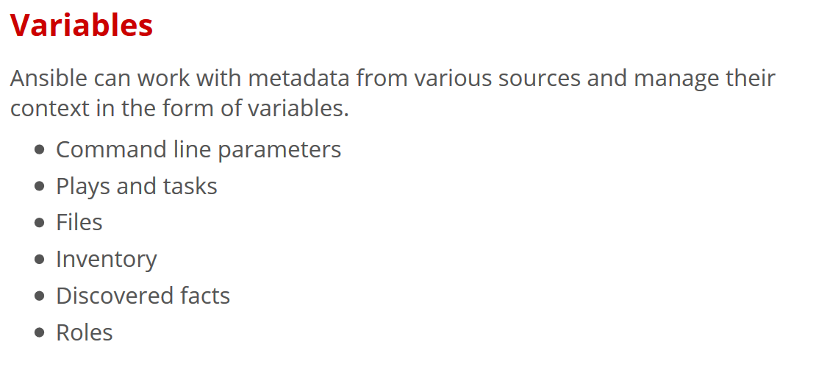

Slide 46
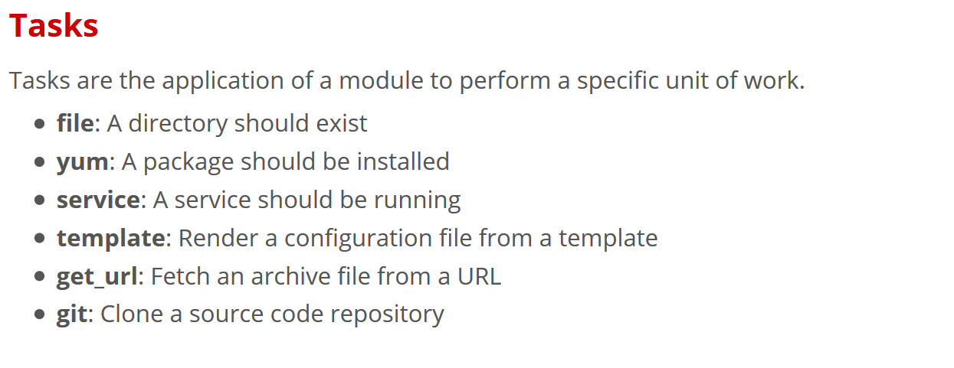

Slide 47
Example Tasks in a Play
tasks:
name: Ensure httpd package is present
yum:
name: httpd
state: latest
name: Ensure latest index.html is present
copy:
src: files/index.html
dest: /var/www/html
name: Restart httpd
service:
name: httpd
state: restarted

Slide 48
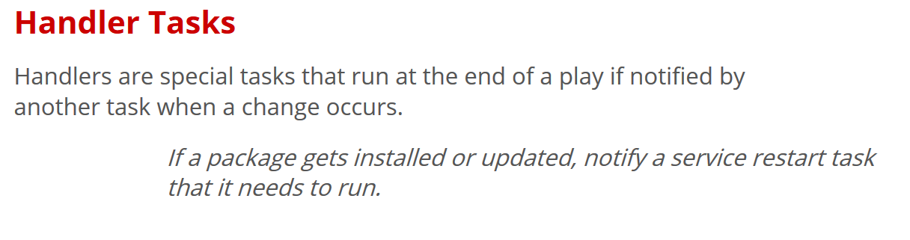

Slide 49
Example Handler Task in a Play
tasks:
name: Ensure httpd package is present
yum:
name: httpd
state: latest
notify: restart_httpd
name: Ensure latest index.html is present
copy:
src: files/index.html
dest: /var/www/html
handlers
name: restart_httpd
service:
name: httpd
state: restarted

Slide 50
Lab 3 : Simple_Playbook (nginx)

Slide 51
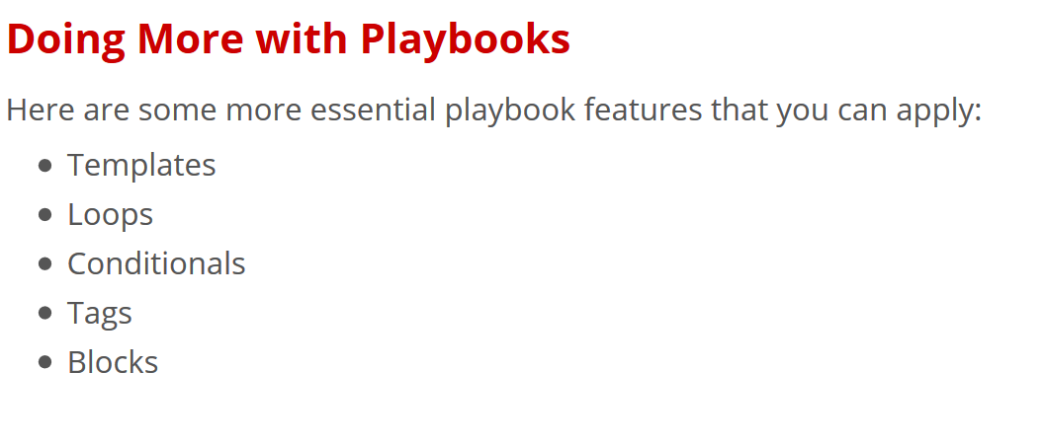

Slide 52
Lab 4 : Basic_Playbook (a more practical playbook)

Slide 53
Roles
Roles are a packages of closely related Ansible content that can be shared more easily than plays alone.
Improves readability and maintainability of complex plays
Eases sharing, reuse and standardization of automation processes
Enables Ansible content to exist independently of playbooks, projects -- even organizations
Provides functional conveniences such as file path resolution and default values

Slide 54
Project with Embedded Roles Example
site.yml
roles/
common/
files/
templates/
tasks/
handlers/
vars/
defaults/
meta/
Apache/
files/
templates/
tasks/
handlers/
vars/
defaults/
meta/

Slide 55
Project with Embedded Roles Example
# site.yml
---
name: Execute common and apache role
hosts: web
roles:
- common
- apache

Slide 56
Lab 5 : Roles

Slide 57
Next Steps
It's easy to get started ansible.com/get-started
Join the Ansible community ansible.com/community
Would you like to learn a lot more? redhat.com/en/services/training/do407-automation-ansible

Slide 58
Introduction to Ansible Tower

Slide 59
What You Will Learn
What is Ansible Tower
How Ansible Tower Works
Installing Ansible Tower
Key Features

Slide 60
What is Ansible Tower?
Ansible Tower is an enterprise framework for controlling, securing and managing your Ansible automation – with a UI and RESTful API
Role-based access control keeps environments secure, and teams efficient
Non-privileged users can safely deploy entire applications with push-button deployment access
All Ansible automations are centrally logged, ensuring complete auditability and compliance

Slide 61
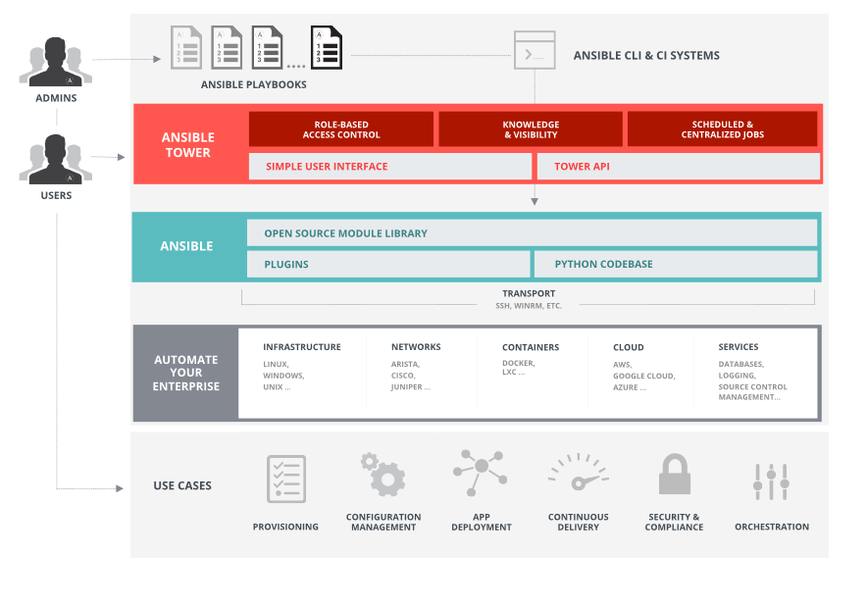
Platform Overview

Slide 62
Installing Ansible Tower
Download the latest Ansible Tower package
$ curl -O https://releases.ansible.com/ansible-tower/setup-bundle/ansible-tower-setup-bundle-latest.el7.tar.gz
Untar and unzip the package file
$ tar xvfz /tmp/ansible-tower-setup- (Name of tar file that was downloaded)*
Change directories into the ansible tower package
$ cd /tmp/ansible-tower-setup
Using an editor of your choice, open the inventory file
$ vi inventory
Fill a few variables out in an inventory file: admin_password, rabbitmq_password, pg_password
Run the Ansible Tower setup script
$ sudo ./setup.sh

Slide 63
Server Requirements
Red Hat Enterprise Linux (RHEL) 7 (and select derivatives), Ubuntu 14.04 64-bit, and Ubuntu 16.04 LTS 64-bit support required (kernel and runtime).
A currently supported version of Mozilla Firefox or Google Chrome.
2 GB RAM minimum (4+ GB RAM highly recommended)
20 GB of dedicated hard disk space

Slide 64
Lab : Installing Ansible Tower

Slide 65
Key Features of Ansible Tower
Dashboard and User Interface
User Base -- Organizations, Teams & Users
Credentials
Inventories
Projects
Job Templates & Jobs
Role Based Access Control (RBAC)

Slide 66
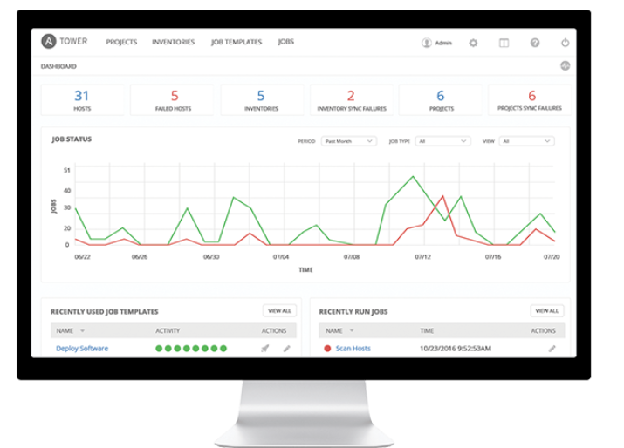
Dashboard and User Interface

Slide 67
User Base
A user is an account to access Ansible Tower and its services given the permissions granted to it.
An organization is a logical collection of users, teams, projects, inventories and more. All entities belong to an organization with the exception of users.
Teams provide a means to implement role-based access control schemes and delegate responsibilities across organizations.

Slide 68
Credentials
Credentials are utilized by Ansible Tower for authentication with various external resources:
Connecting to remote machines to run jobs
Syncing with inventory sources
Importing project content from version control systems
Connecting to and managing networking devices
Centralized management of various credentials allows end users to leverage a secret without ever exposing that secret to them.

Slide 69
Inventory
Inventory is a collection of hosts (nodes) with associated data and groupings that Ansible Tower can connect to and manage.
Hosts (nodes)
Groups
Inventory-specific data (variables)
Static or dynamic sources

Slide 70
Projects
A Project is a logical collection of Ansible Playbooks, represented in Ansible Tower.
You can manage Playbooks and Playbook directories by placing them in a source code management system supported by Ansible Tower, including Git, Subversion, and Mercurial.

Slide 71
Job Templates
A job template is a definition and set of parameters for running an Ansible Playbook. Job templates are useful to execute the same job many times and encourage the reuse of Ansible Playbook content and collaboration between teams.

Slide 72
Jobs
A job is an instance of Ansible Tower launching an Ansible Playbook against an inventory of hosts.
Job results can be easily viewed
View the standard out for a more in-depth look

Slide 73
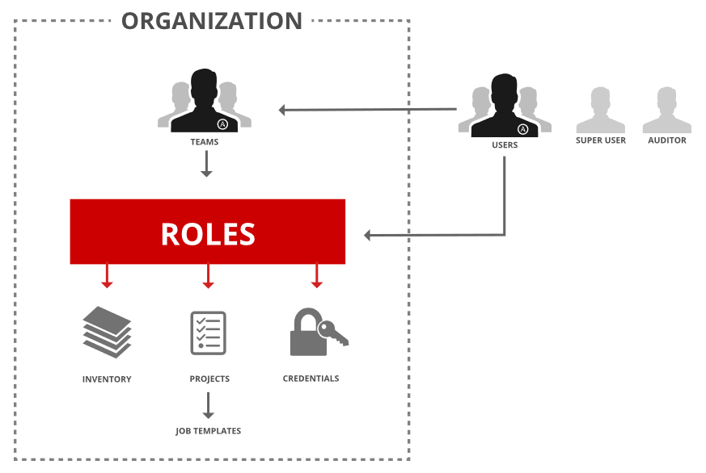
Role Based Access Control (RBAC)
Role-Based Access Controls (RBAC) are built into Ansible Tower and allow administrators to delegate access to server inventories, organizations, and more. These controls allow Ansible Tower to help you increase security and streamline management of your Ansible automation.

Slide 74
Lab : Configuring Ansible Tower

Slide 75
Dynamic Inventory in Ansible Tower
Dynamic inventory is a script that queries a service, like a cloud provider API or a management application. This data is formatted in an Ansible-specific JSON data structure and is used in lieu of static inventory files.
Groups are generated based on host metadata
Single source of truth saves time, avoids duplication and reduces human error
Dynamic and static inventory sources can be used together

Slide 76
More with Ansible Tower
Job Status Updates
Activity Stream
Integrated Notifications
Schedule Jobs
Manage and Track Your Inventory
Self Service IT (User Surveys)
Remote Command Execution
External Logging
Multi-Playbook Workflows

Slide 77
Next Steps
It’s easy to get started ansible.com/get-started
Try Ansible Tower for free: ansible.com/tower-trial
Would you like to learn a lot more? redhat.com/en/services/training/do409-automation-ansible-ii-ansible-tower

Slide 78
Lab : Creating and Running
Job Template

Slide 79
THANK YOU
plus.google.com/+RedHat
facebook.com/redhatinc
linkedin.com/company/red-hat
twitter.com/RedHatNews
youtube.com/user/RedHatVideos

Slide 80
